Slide 1
Paging in OS

Slide 2
Paging in Operating System
Paging is a memory management scheme that eliminates the need for a contiguous allocation of physical memory. The process of retrieving processes in the form of pages from the secondary storage into the main memory is known as paging.
The basic purpose of paging is to separate each procedure into pages. Additionally, frames will be used to split the main memory. This scheme permits the physical address space of a process to be non – contiguous.

Slide 3
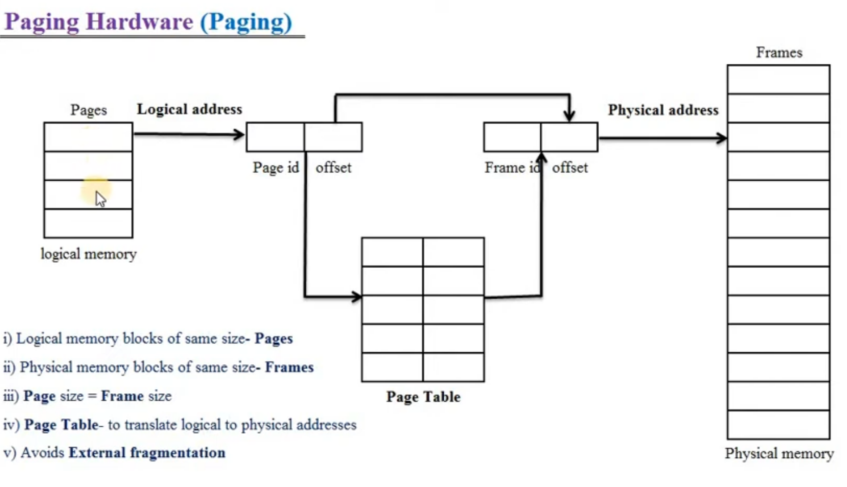

Slide 4
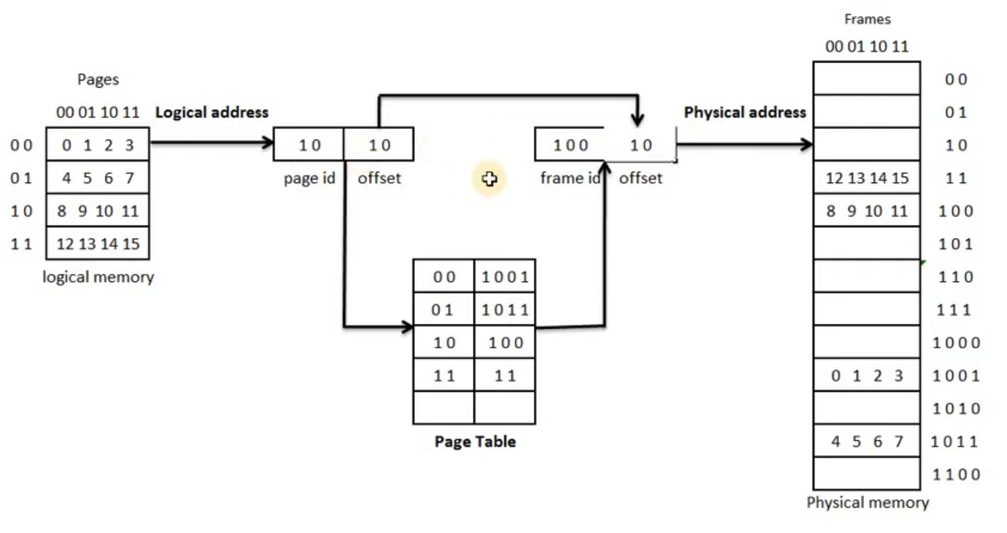

Slide 5
Paging in Operating System
In paging, the physical memory is divided into fixed-size blocks called page frames, which are the same size as the pages used by the process.
The process’s logical address space is also divided into fixed-size blocks called pages, which are the same size as the page frames. When a process requests memory, the operating system allocates one or more page frames to the process and maps the process’s logical pages to the physical page frames.

Slide 6
Paging in Operating System
The mapping between logical pages and physical page frames is maintained by the page table, which is used by the memory management unit to translate logical addresses into physical addresses.
The page table maps each logical page number to a physical page frame number.

